Slide 1
Why Kubernetes? Evolution of Kubernetes

Slide 2
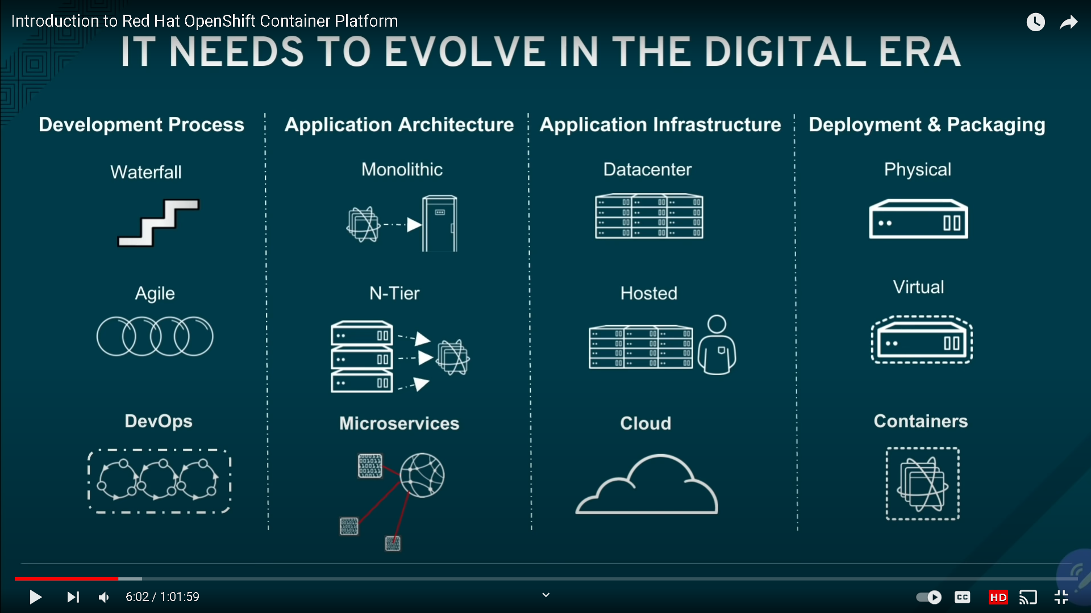

Slide 3
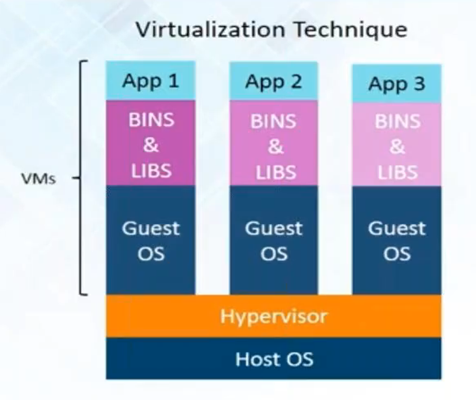
Advantages
Multiple OS in same machine
Easy maintenance & recovery
Lower total cost of ownership
Problems
Mutiple VM’s lead to unstable performance
Hypervisors are not as efficient as host OS
Long boot-up process
Single point of Failure

Slide 4
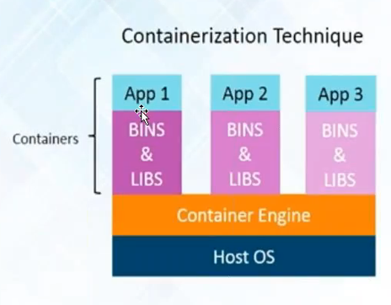
Advantages over virtualization
Containers on same OS are lighter and smaller
Better resource utilization compared to VM’s
Short boot-up process

Slide 5
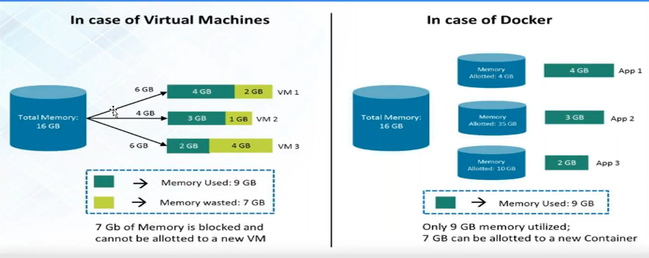

Slide 6
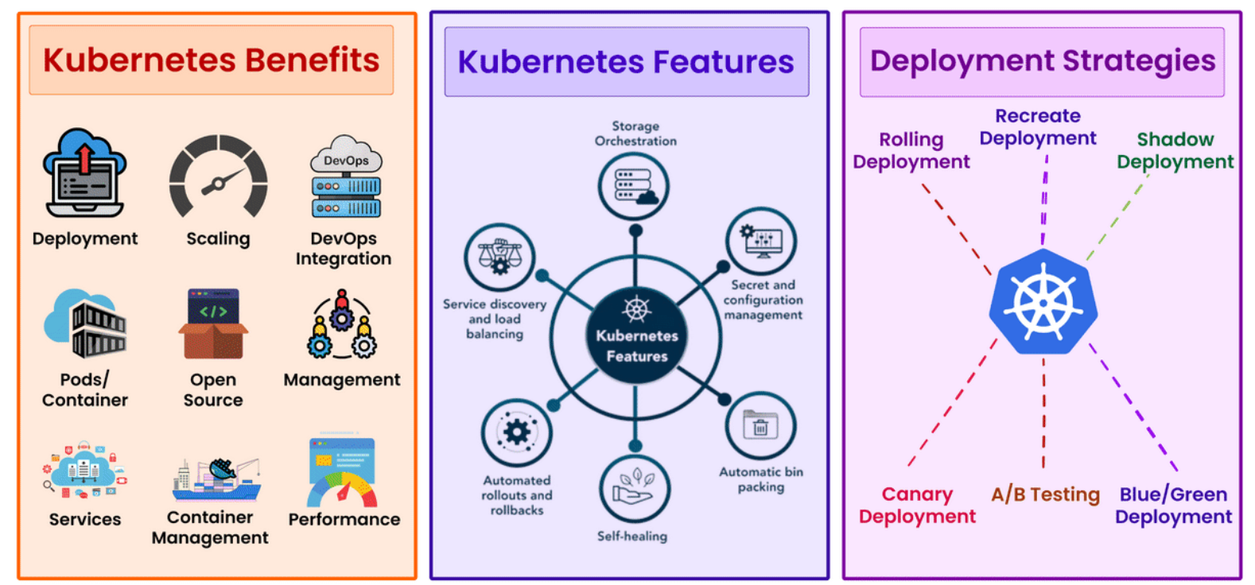

Slide 7
Why kubernetes
High availability
Autoscaling is not available in docker swarm
Self healing and seamless upgrading or Rollback of applications
Can Scale up and scale down dynamically
Enterprise level support
Health checks (liveness, readiness, startup’s)
Advanced load balancing capabilities
Advanced networking capabilities

Slide 8
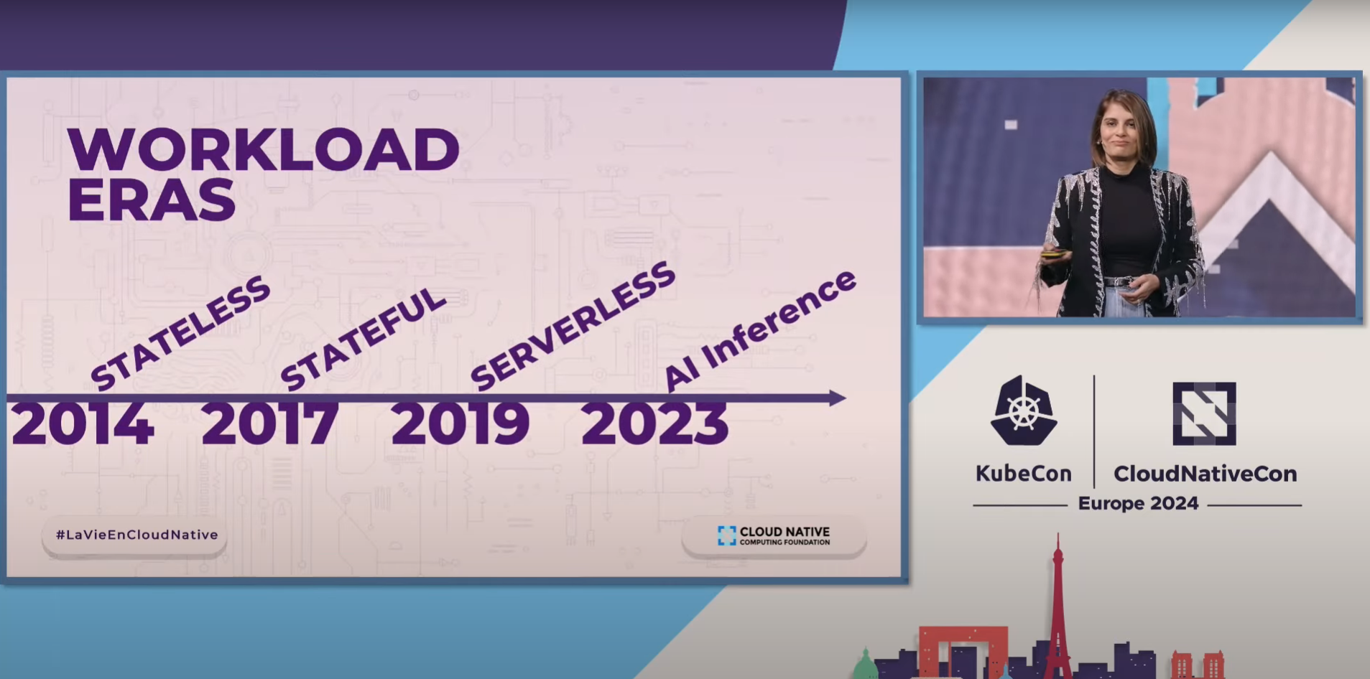

Slide 9
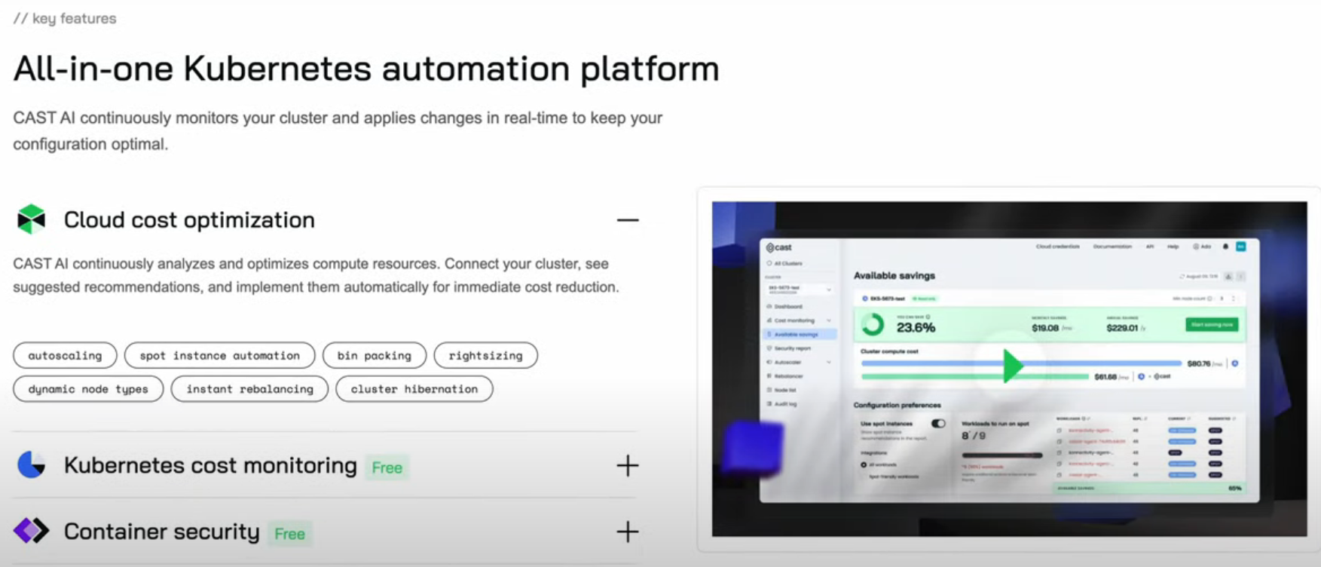

Slide 10
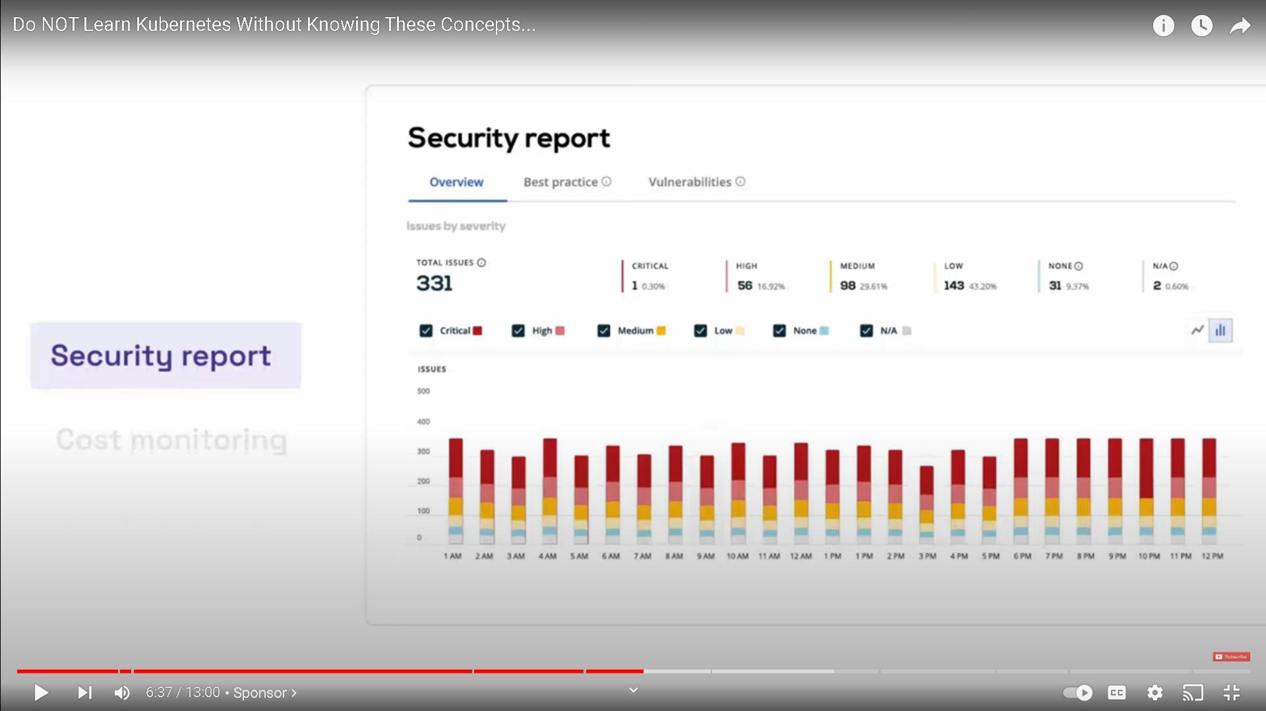

Slide 11
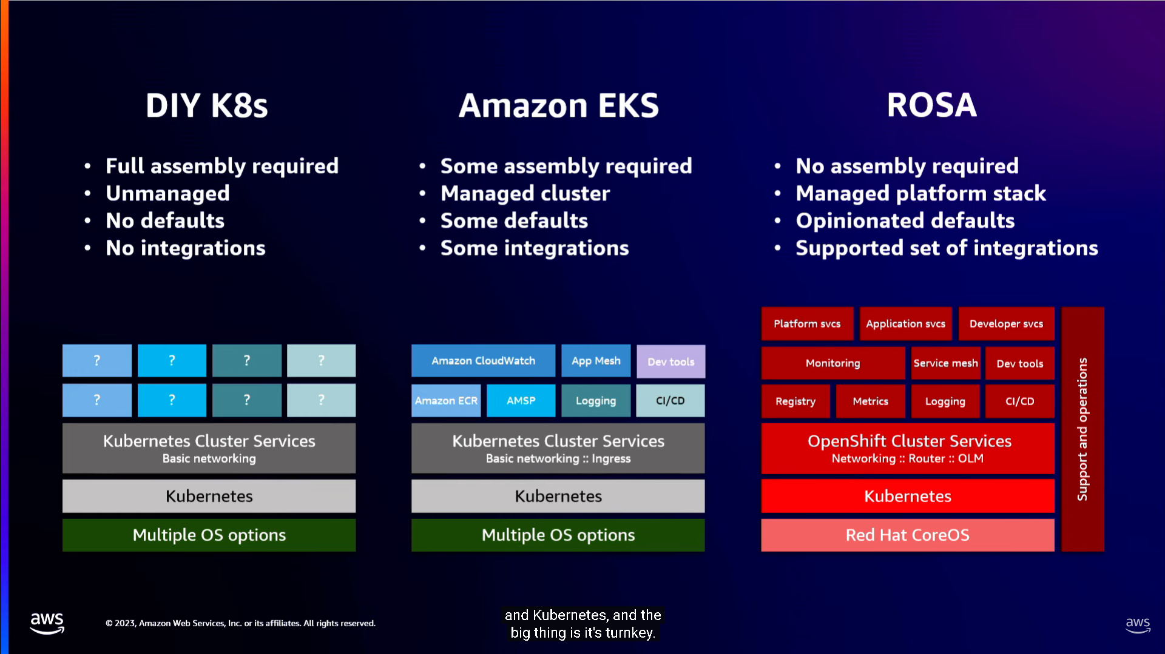

Slide 12
KUBERNETS ARCHITECTURE
Kubernetes operates on a master-slave architecture.
Master nodes:
Controls the cluster
It is a many entry point for all tasks
Worker nodes:
Run’s applications.
Worker nodes listen to the API Server for new work; they execute the work and then report the results back to the Kubernetes Master node.

Slide 13
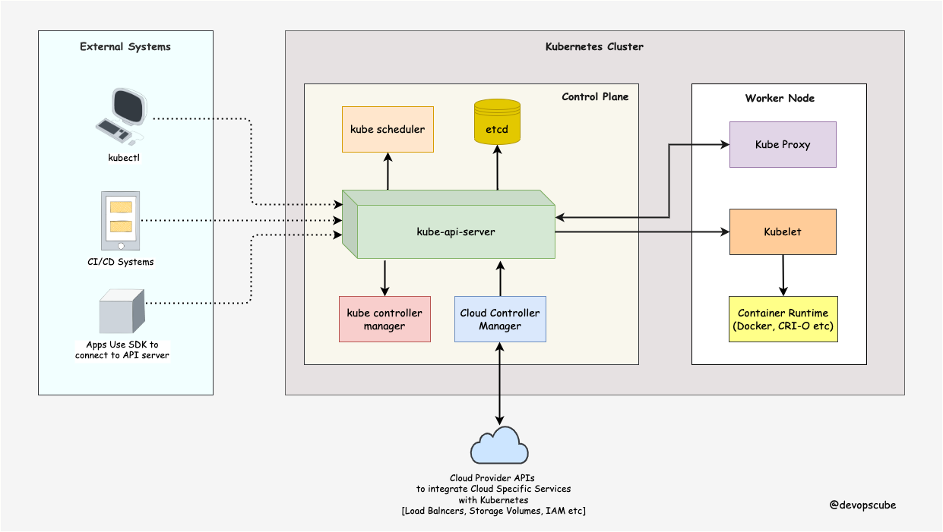
Kubernetes cluster

Slide 14
Master node components
API-server :
It’s a main component of cluster and all components connected to Api server.
All the requests will go through and from API server
All the cluster requests are authenticated and authorized by the API server.
The API server has a watch mechanism for watching the changes in the cluster
Scheduler / kube-scheduler:
It’s the decision-maker responsible for scheduling pods on worker nodes.

Slide 15
etcd :
The key-value pair storage that stores all the important cluster information for reference and tracking
control manager / kube-controller :
It is a collection of controllers that helps to manage and maintain the desired state of the cluster.
cloud controller manager
The cloud controller manager integrates with cloud provider’s controllers to manage resources on cluster

Slide 16
Worker node components
Kubelet:
The kubelet is like a agent that runs on each worker node in the cluster.
It creates and manages pods.
Reports the pod's health and it’s status.
kube service proxy :
The kube-proxy in Kubernetes is responsible for managing network-related configuration.
Based on the configuration service proxy manages the entire network of worker nodes.
Container Runtime : Manages containers.

Slide 17
Cluster setup with Kubeadm
There are multiple ways to setup Kubernetes cluster like Kubeadm and Kops
Introduction to Kubeadm
Kubeadm is a tool provided by Kubernetes to simplify the process of installing and configuring a production-ready Kubernetes cluster.
It handles the installation of the Kubernetes control plane and worker nodes.

Slide 18
Prerequisites for Kubeadm Installation
Infrastructure:
At least Three Linux nodes (1 control plane and 2 worker node).
2 GB or more RAM per machine.
2 CPUs or more.
Operating System:
Supported OS: Ubuntu, CentOS, Red Hat, or similar Linux distributions.
Software Dependencies:
Install containerd (or any other CRI - Container Runtime Interface) for container management.
Install Kubeadm, kubelet, and kubectl binaries.

Slide 19
Step 1: Create master (control plane)
curl -s https://raw.githubusercontent.com/jaintpharsha/install/main/k8s/cluster_setup_using_kubeadm_new.sh| bash -s master
Step 2: Create worker node
curl -s https://raw.githubusercontent.com/jaintpharsha/install/main/k8s/cluster_setup_using_kubeadm_new.sh | bash -s worker

